Slide 1
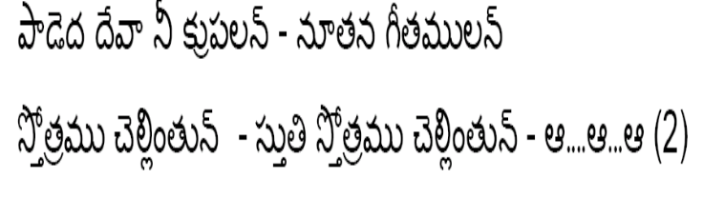
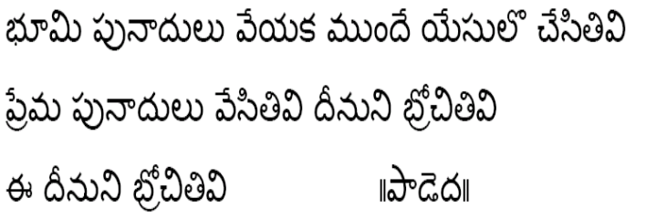
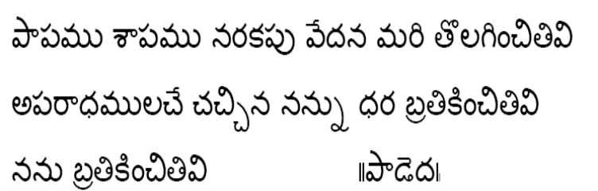
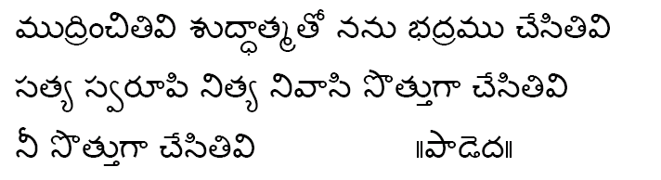
Paadeda deva nee krupaalan - nootana geetamulan strotramu chellintun - stuti strotramu chellintun - A....A...A (2) Bhoomi punaadulu veyaka munde yesulo chesitivi || 2 || prema punaadulu vesitivi deenuni brochitivi nee deenuni brochitivi ||Paadeda|| paapamu shaapamu narakapu vedana mari tolaginchitivi || 2 || aparaadhamulache chachina nannu dhara bratikinchitivi nanu bratikinchitivi ||Paadeda|| mudrinchitivi shuddhaatmato nanu bhadramu chesitivi || 2 || satya svaroopi nitya nivaasi sottugaa chesitivi nee sottugaa chesitivi ||Paadeda||

